Slide 1
Parte 2 (III)
Data Integration - JSON
Instituto Politécnico do Cávado do Ave
Escola Superior de Tecnologia
LESI

Slide 2
JSON
Json (JavaScript Object Notation)
Extensão: .json
Internet media: application/json
Standard: RFC 4627
          http://tools.ietf.org/html/rfc4627
JSON is smaller than XML, and faster and easier to parse…
As XML, is another (text) data format to “represent” and serialize data

Slide 3
JSON
Json (JavaScript Object Notation)
Use Javascript sintax to describe objects
Data are tuples “name : value”;
Data are separated by “,”
“{“ “}” for objects (‘Curly brackets’)
“[“ “]” for arrays
http://www.json.org/
http://www.jsonexample.com/
          http://desenvolvimentoparaweb.com/javascript/json-javascript-object-notation/
myObject =
{
"first": "John",
"last": "Doe",
"age": 39,
"sex": "M",
"salary": 70000,
"registered": true,
"interests": [ "Reading", "Mountain Biking", "Hacking" ]
}

Slide 4
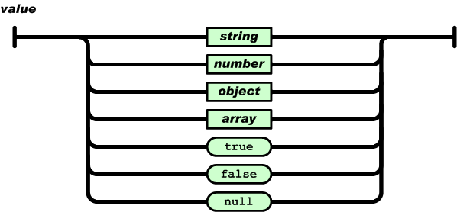
JSON
Json (JavaScript Object Notation)

Slide 5
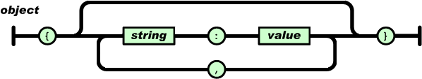
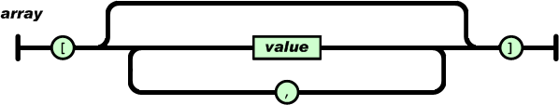
JSON
Json (JavaScript Object Notation)

Slide 6
JSON
Json (JavaScript Object Notation)
Array:
  ["Domingo", "Segunda", "Terça", "Quarta", "Quinta", "Sexta", "Sábado"]
  [ 33, "Segunda", TRUE, 3.14159265, NULL ]
  [{“nome”:”Zé”, “curso”: “LESI”}, {“nome”:”Maria”, “curso”: “LESI”}]
[ “…”,1224, [...], {...} ]

Slide 7
JSON
Json (JavaScript Object Notation)
Objects:
  {“nome”:”Zé”, “curso”: “LESI”}
  {“ID”:”1234”, “total”: 123}
    { “Benfica" : “Maior",
    “Porto" : “Fraquinho",
    “Braga" : “Coitado”
    }
tuples “name : value”

Slide 8
JSON
Json (JavaScript Object Notation)
Values:
  “firstName” : “Antonio”
  “total” : 123
  “alunos” : [{“nome”:”Zé”, “curso”: “LESI”}]
Types:
number (inteiro ou float)
string (entre aspas)
boolean (true ou false)
array (entre “[ ]”)
object (entre “{}”)
null

Slide 9
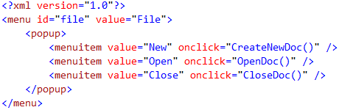
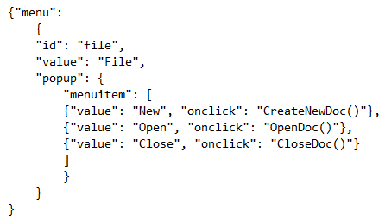
XML2JSON
Json (JavaScript Object Notation)

Slide 10
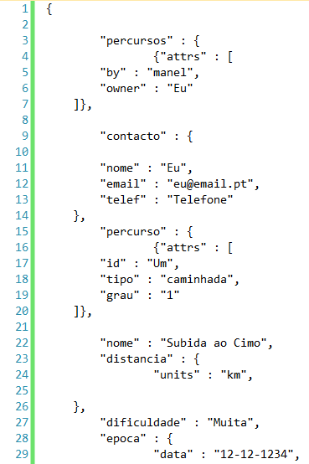
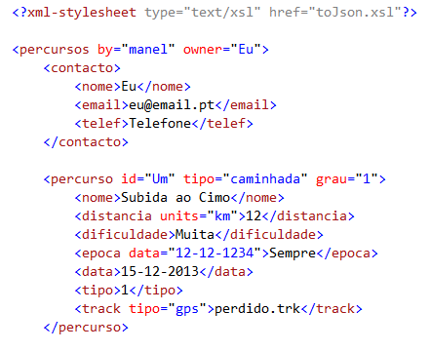
XML2JSON
XML to Json

Slide 11
Transforming XML|JSON docs …
Using:
  C# (explore!)
  JAVA
  PHP
  JavaScript
  Others…

Slide 12
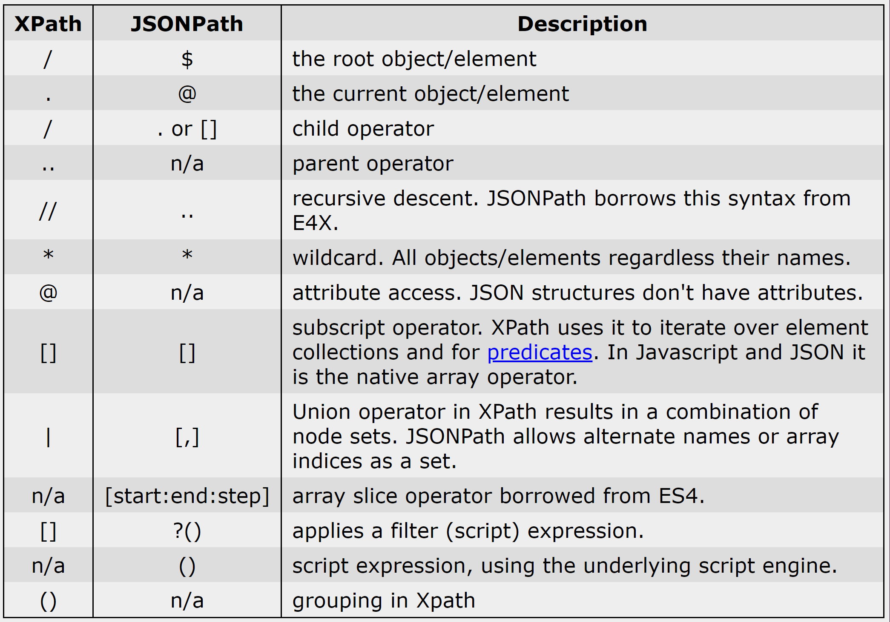
ISI
Json Path
https://goessner.net/articles/JsonPath/

Slide 13
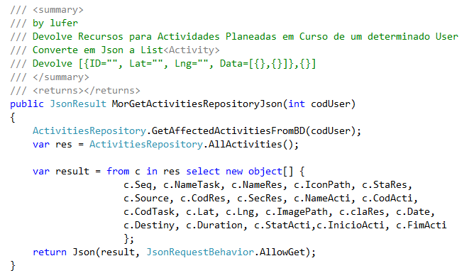
2JSON
Json (JavaScript Object Notation)
Collection List
to Json in C#/Linq

Slide 14
References
C# JSON
https://zetcode.com/csharp/json/
JSON/C#:
https://www.w3schools.com/js/js_json_intro.asp
https://csharp.net-tutorials.com/xml/introduction/
https://www.c-sharpcorner.com/article/from-zero-to-hero-in-json-with-c-shar/
https://sodocumentation.net/csharp/topic/9910/getting-started--json-with-csharp
Notes:
https://docs.microsoft.com/en-us/dotnet/standard/data/xml/select-nodes-using-xpath-navigation
Select Nodes Using XPath Navigation
03/30/2017
4 minutes to read
+5
The XML Document Object Model (DOM) contains methods that allow you to use XML Path Language (XPath) navigation to query information in the DOM. You can use XPath to find a single, specific node or to find all nodes that match some criteria.

